Slide 1
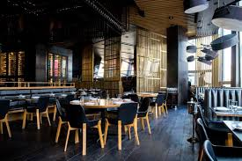
CAFE TABLE RESERVATION SYSTEM

Slide 2
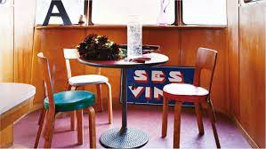
Project members(group : 2)
PRESENTED BY:
1.Challa Hemavathi
2.Boddupelli Srikanth
3.Bukkey Rakesh Naik
4.Chaitra X
5.Chintaginjala Srinadh
6.Devarinti Joshna
7.Devu Pochesh
8.Dharavath Mounika
9.Bidholla Jyothi
10.Budiputi Nithisha

Slide 3
Introduction
This online café table reservation system consists of two parts,
1. User
2. Admin
The User of the application which will be used fortable reservation, look up and filter the menu, contact the cafe team and even to know the cafe location.
The Admin-portal is being managed by the owner to check the booking and make the availability for the customer.
This application is a convenient self-service table & menu booking system. With this system the booking process can be customized, manage restaurant availability & reservations.
The services provided are menu & table booking managed by the customer through the system.

Slide 4

PORTAL:
1.ADMIN
2.USER

Slide 5
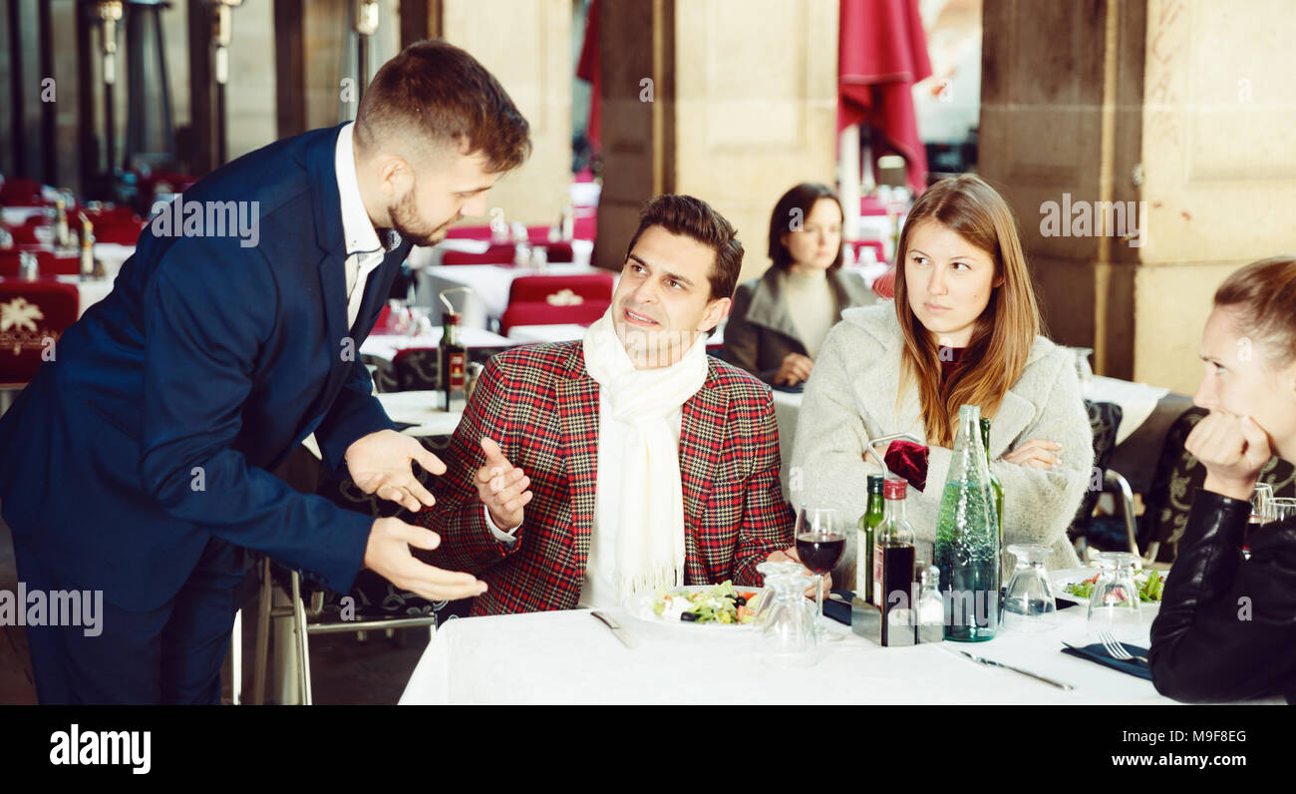
ADMIN
1.Login to Portal
2.Create Admin Account
3.Add or remove new delicacy to the menu and to read from the contact-form
.4.Edit delicacies from the menu carddetails like item name, price,and description to keep the food iteminformation updated with the current prices.
5.Enable or disable the food itemsin the cafe.Below are the key responsibilities and functionalitie

Slide 6
USER
1.Register into the application
2.Sign into the application to maintain the record of activities.
3.Change Password
4.Update Profile
5.Search for tablebased on the search keyword.
6.Apply filters and sort results based on different categoriesof the tables available.(AC room table/ non-ACroom table).
7.Add all the reserved tablesand customize the reservationat the end
8.Experience a seamless online reservationprocess.
9.Receive areservation confirmationsummary page once done with the reservation.

Slide 7

Technologies
Front End : Angular
Server Side: Spring Boot, Spring Data JPA.
Back End : My SQL
Web Server : Tomcat

Slide 8
Software Requirements
IDE Eclipse
Visual Studio Code
My SQL Workbench
OS : Windows

Slide 9
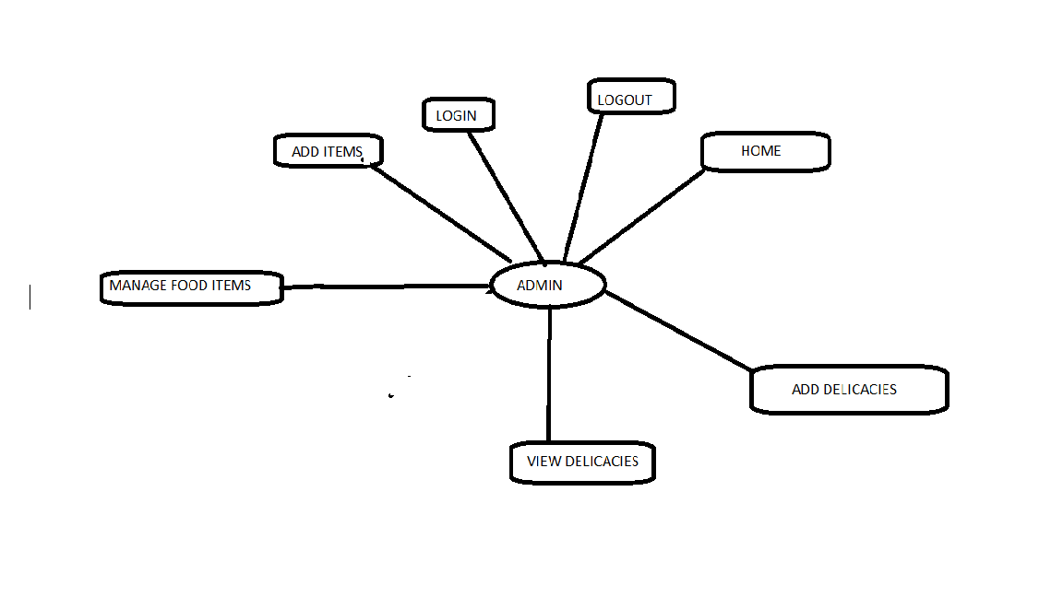
E-R DIAGRAM:ADMIN

Slide 10
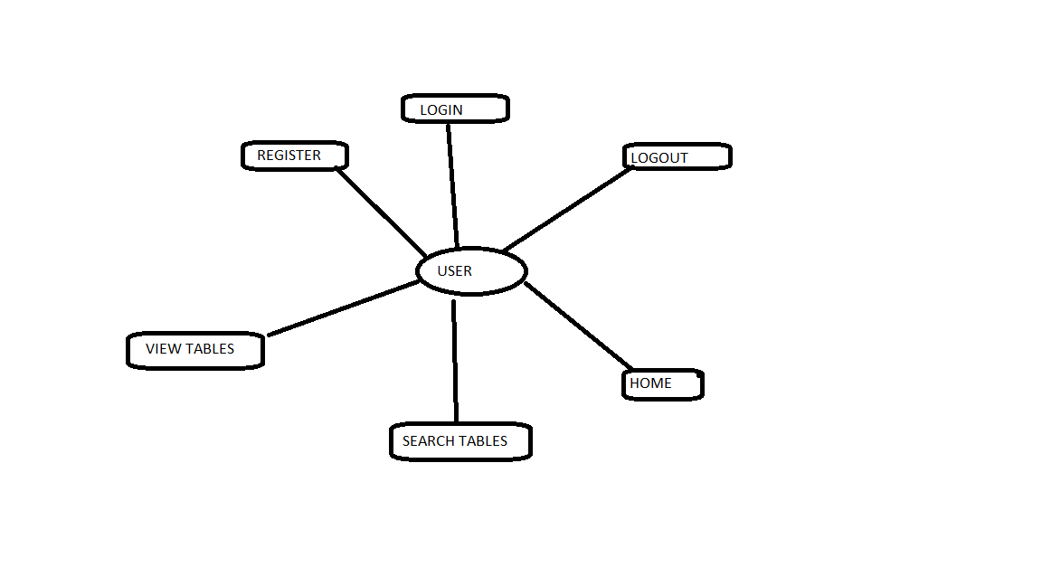
ER-DIAGRAM:USER

Slide 11

ADVANTAGES
Provide greater convenience for customers.
Reduce the risk of human error.
Keep hosts focused on the task at hand
Optimize staffing.
Improve cancellation notifications.
Capture customer information.

Slide 12
TESTING
UNIT TESTING
JUnit is a unit testing framework for Java programming language. It plays a crucial role test-driven development, and is a family of unit testing frameworks collectively known as xUnit.
JUnit is an open source framework, which is used for writing and running tests.
Provides annotations to identify test methods.
Provides assertions for testing expected results.
Provides test runners for running tests.

Slide 13
Functional Testing using POSTMAN Tool :
Tests are automated by creating test suites that can run again and again.
Postman can be used to automate many types of tests including unit tests, functional tests, integration tests, end-to-end tests, regression tests, mock tests, etc. Automated testing prevents human error and streamlines testing.

Slide 14
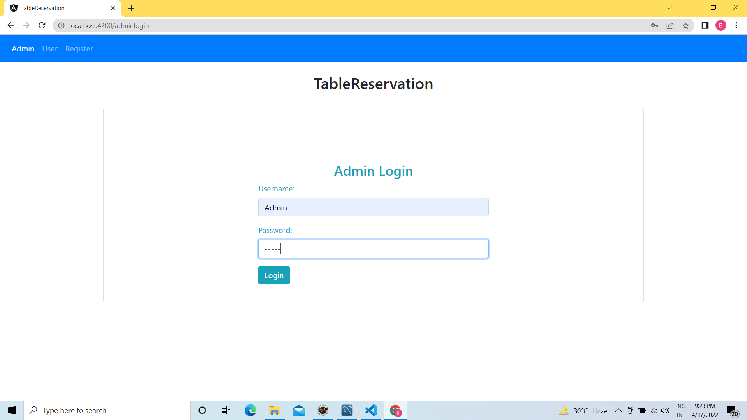
Home page:

Slide 15
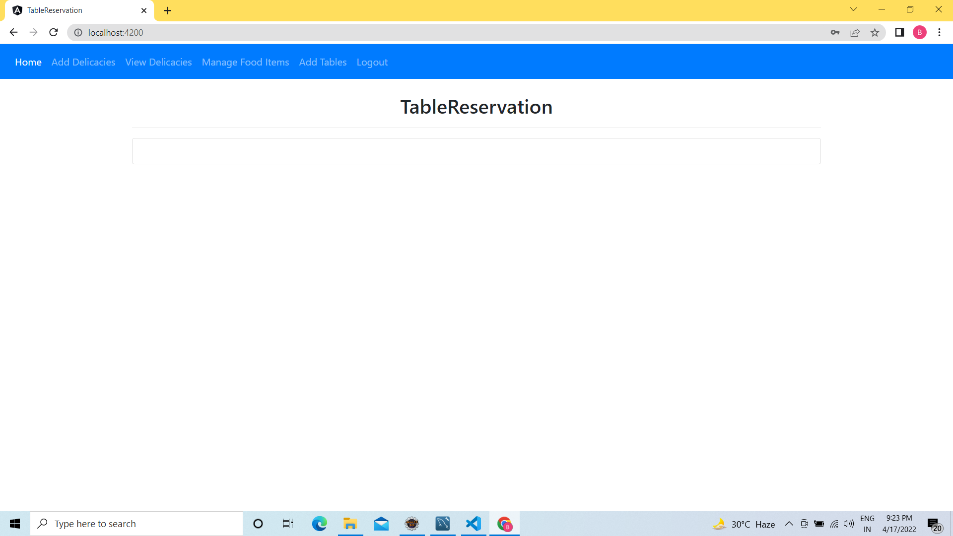
Admin login:

Slide 16
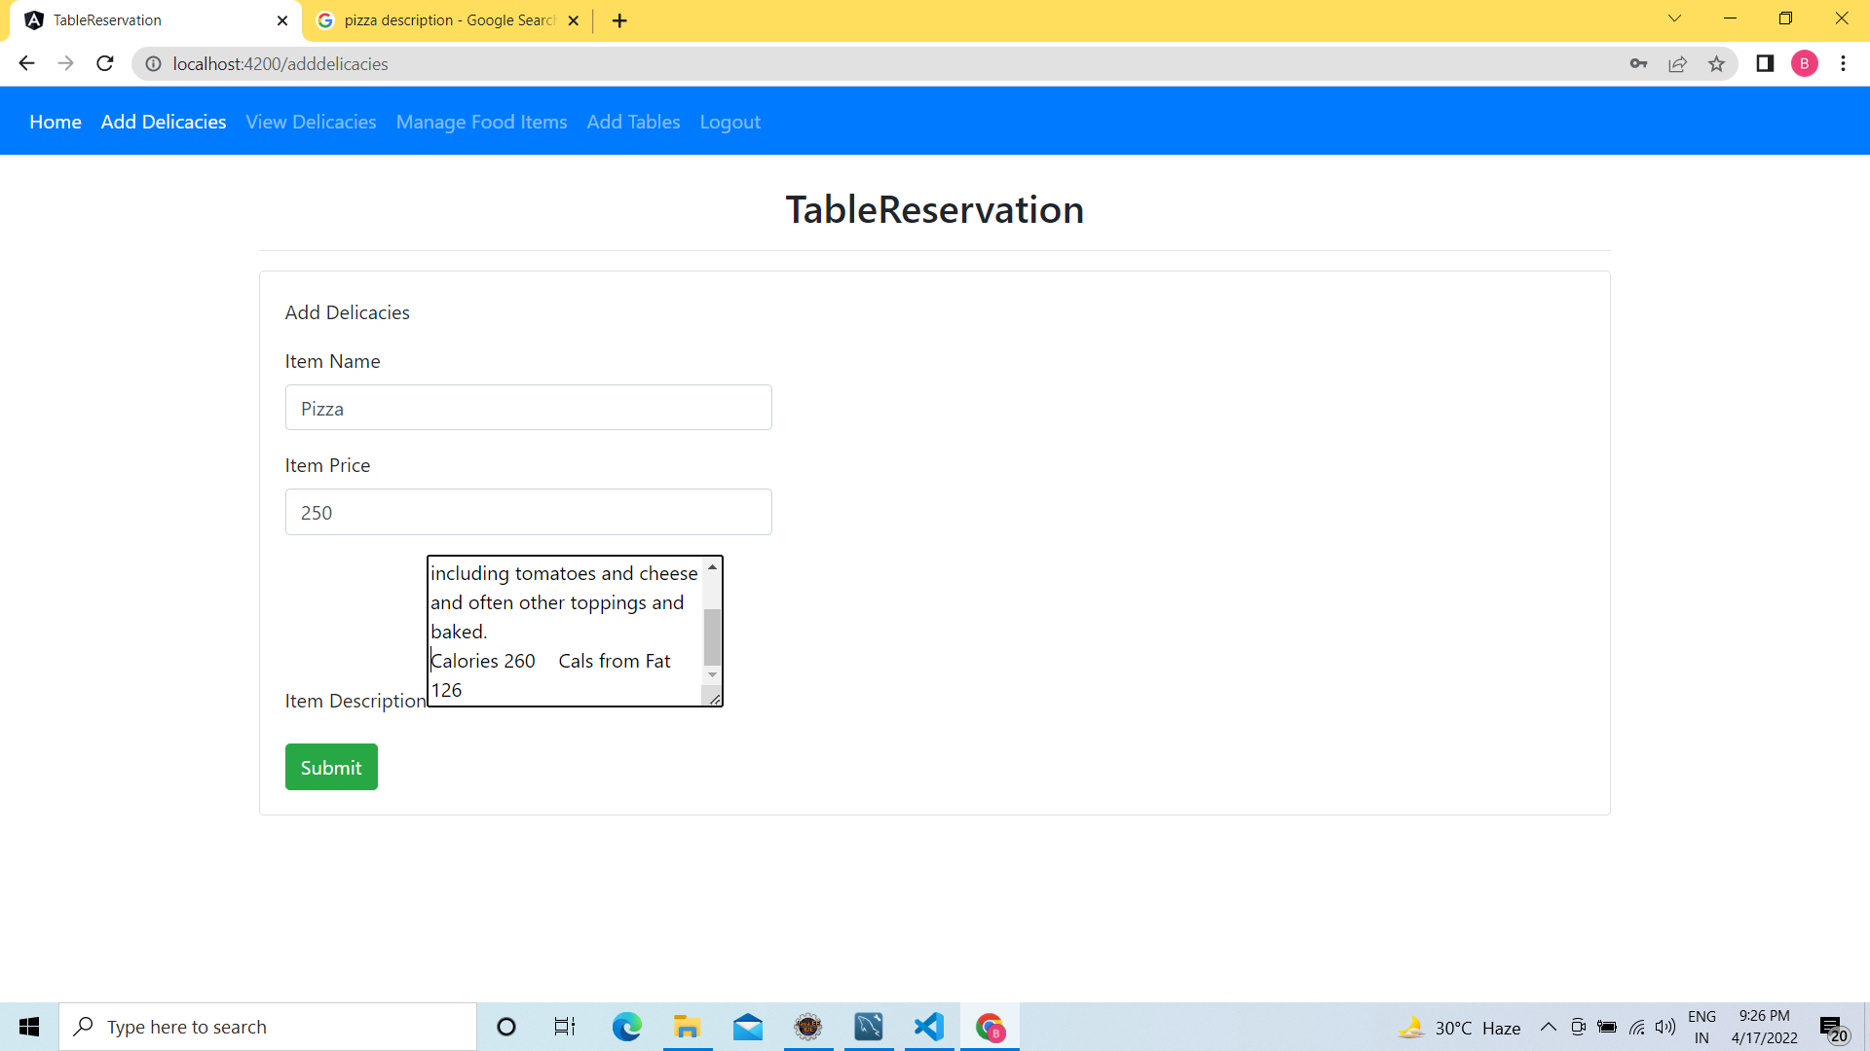
ADD DELICACIES

Slide 17
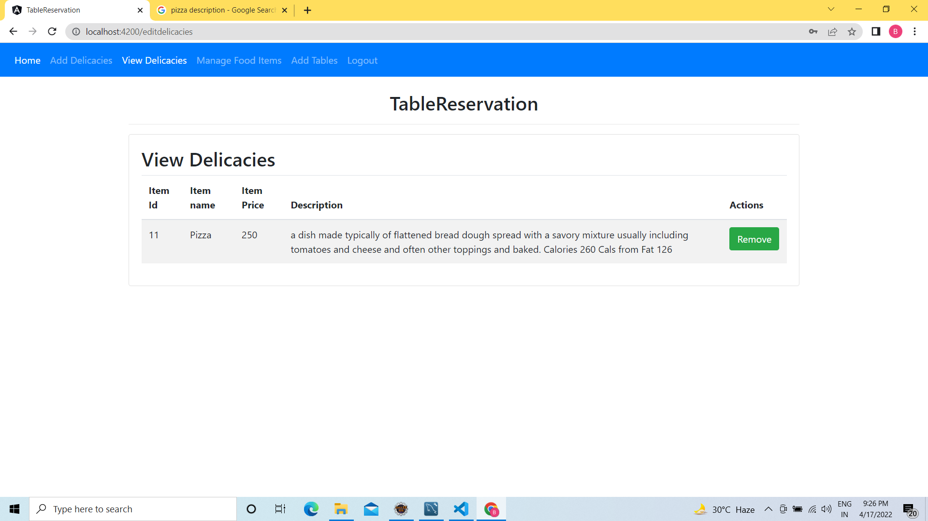
VIEW DELICACIES:

Slide 18
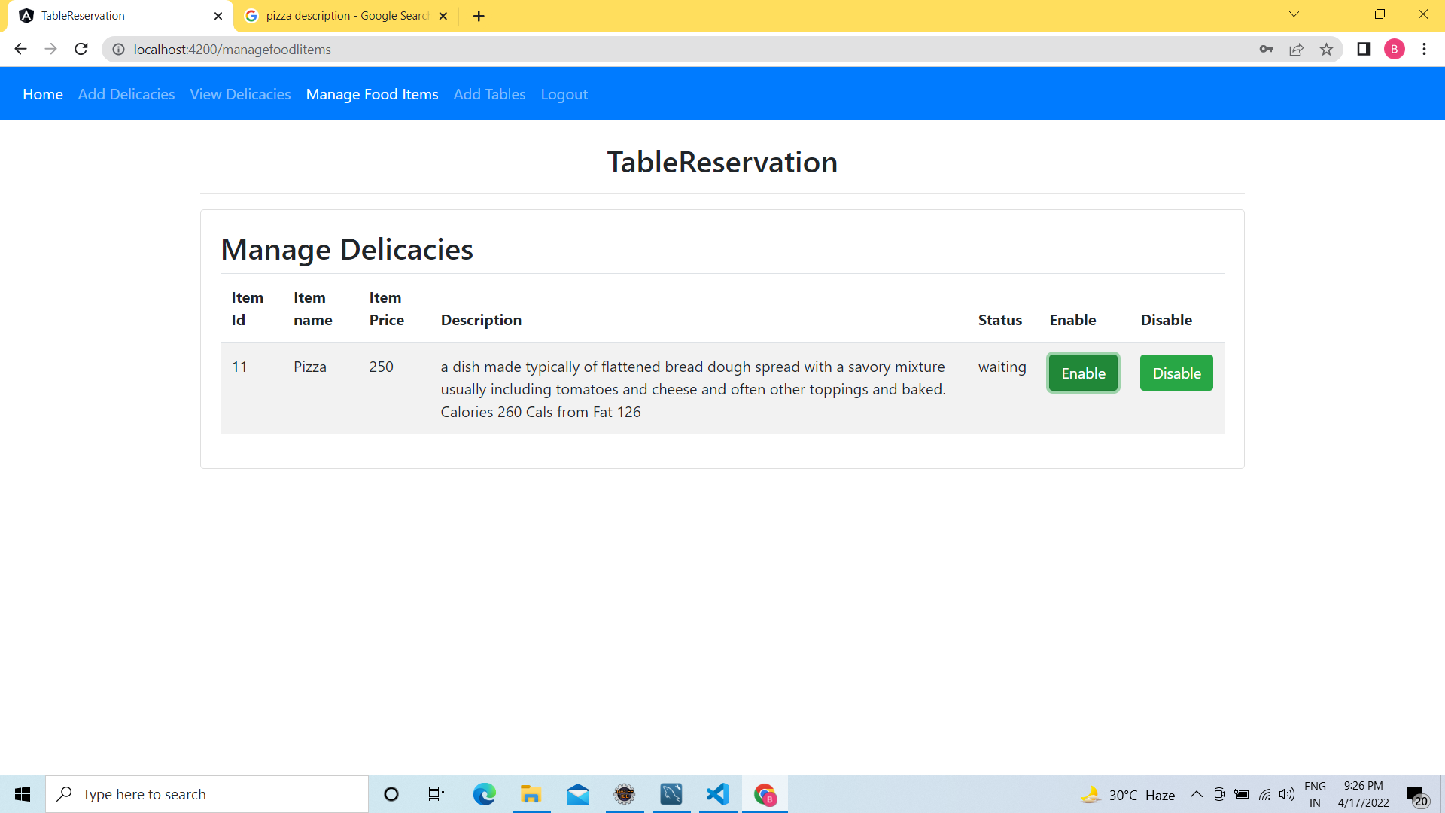
MANAGDE FOOD ITEMS:

Slide 19
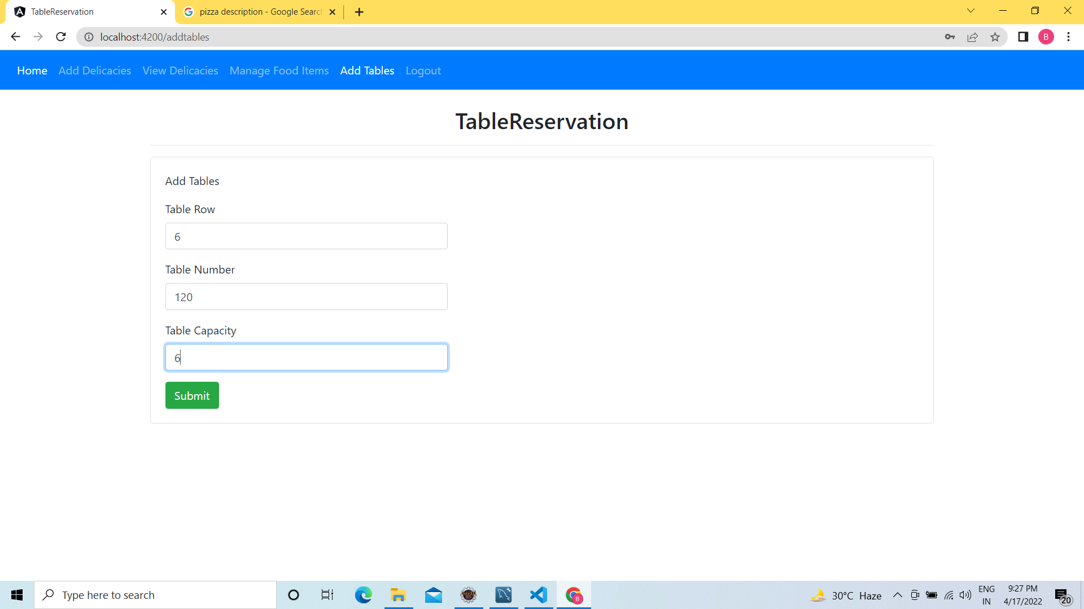
ADD TABLES:

Slide 20
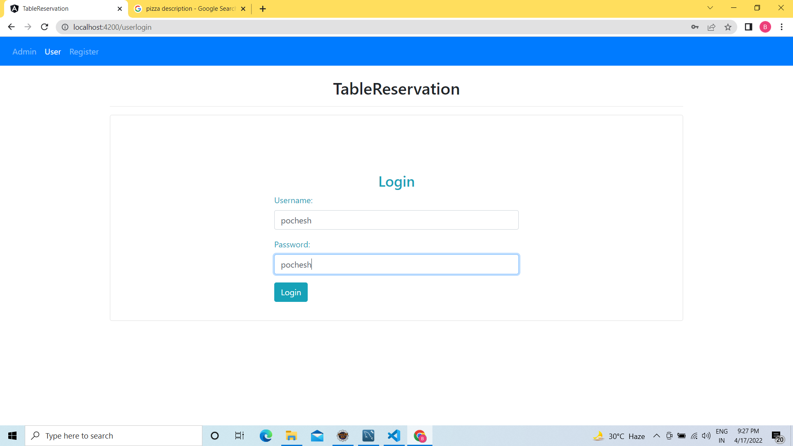
USER LOGIN:

Slide 21
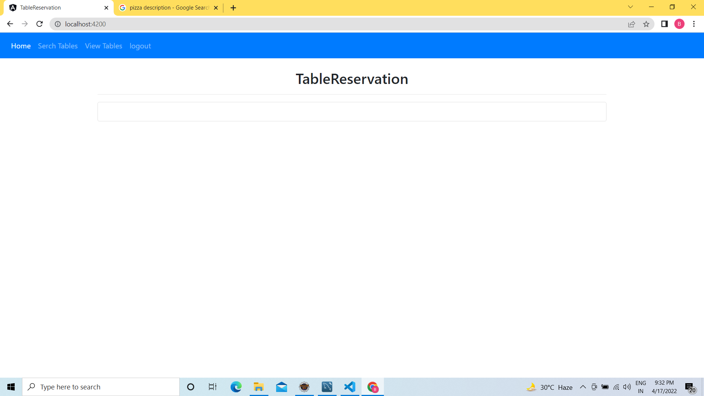
USER COMPONENTS:

Slide 22
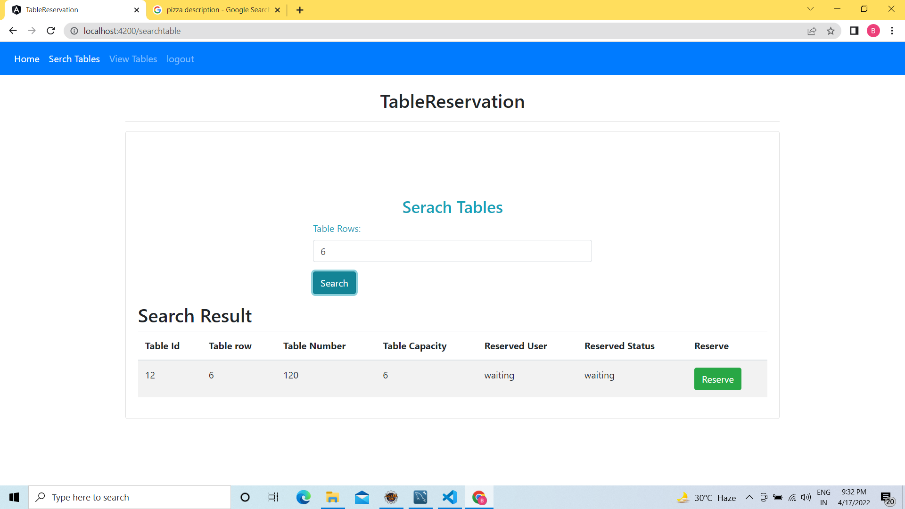
SEARCH TABLES:

Slide 23
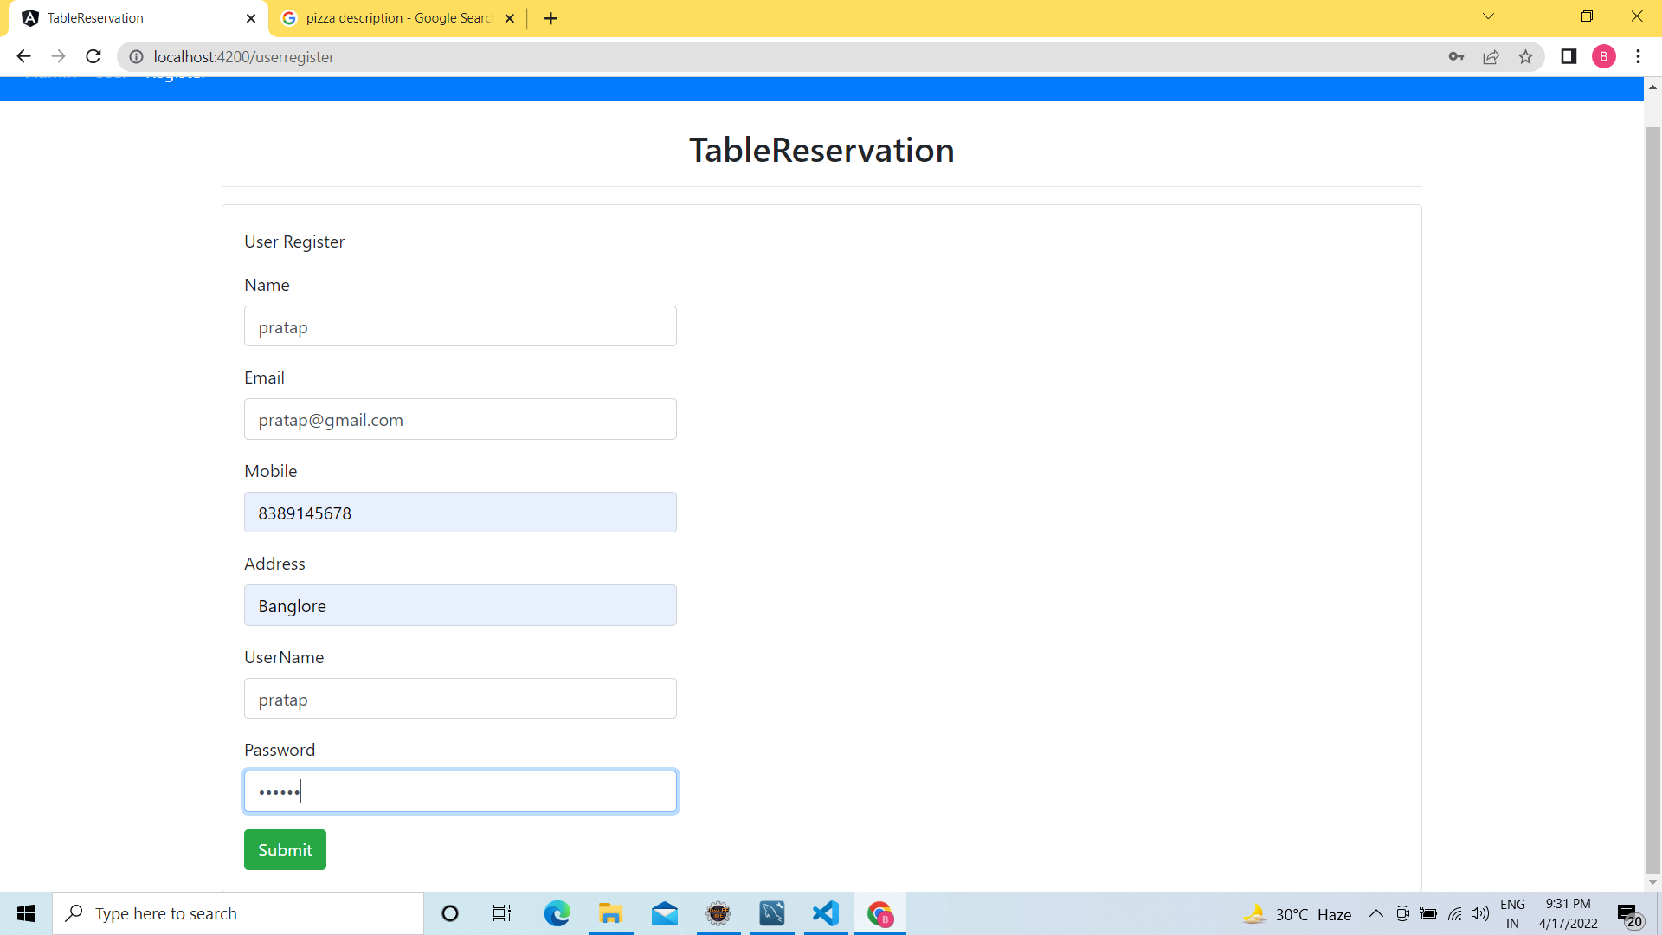
REGISTER:

Slide 24
CONCLUSION:
The project has concluded that if a customer is willing to visit any restaurant and finds no table is available for the meal
Then the customer has to wait long for the table availability. With the help of this application the customer can choose the desired table according to the location.
E.g. Table can be reserved as according to number of members. Moreover, the customer can easily see pictures of interior from the Application.
Keeping in view the demand of proposed project that gives a series of services and provides the customer to book a table and menu without waiting for a long time through an android application.
This application will get its importance as day by day people are getting into android and fast life.

Slide 25


